Slide 1




人工智慧課程
張嘉惠教授
中央大學資訊工程系
2022/09/14

Slide 2


Join at slido.com #8651174
ⓘ Start presenting to display the joining instructions on this slide.

Slide 3
Outline
What is AI? Techniques or Goals?
AI as Goals
AI as Techniques
Course Topics
Grading

Slide 4
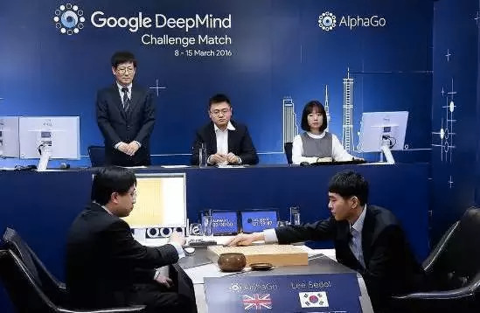
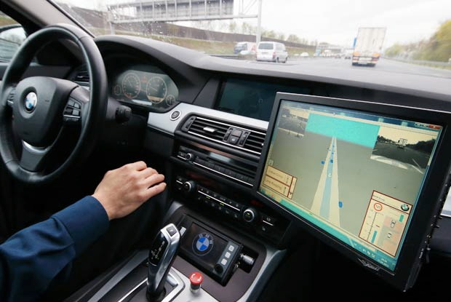
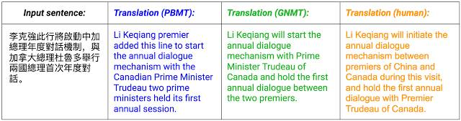
Google AlphaGO, 2016
No hands across America
Google翻譯導入類神經網路的深度學習

Slide 5
What is AI? Techniques or Goals
?
LINK

Slide 6
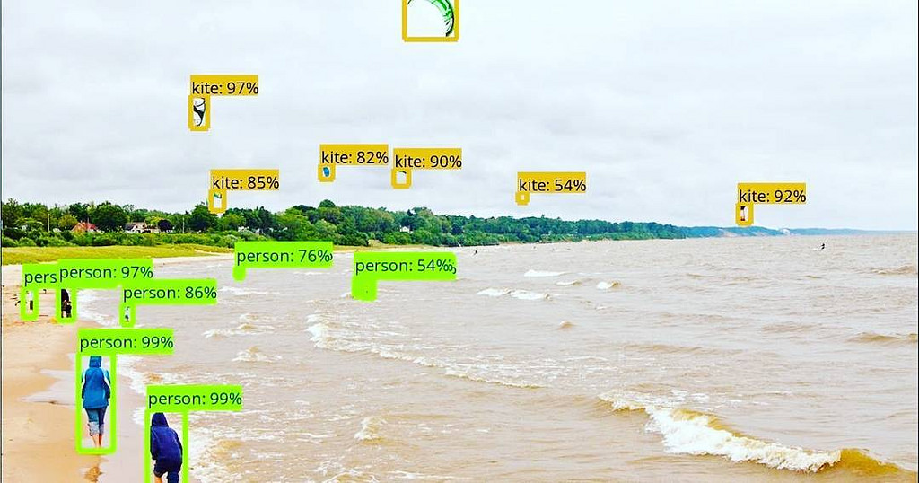
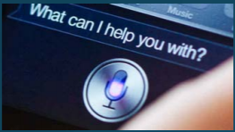
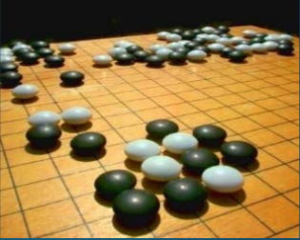
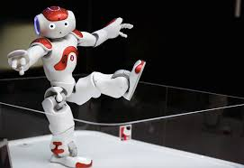
AI as Goals
Perceiving (感知)
視覺, 聽覺
Reasoning (推理)
Action (行動)
Communication (語言)
Learning (學習)
Abstracting (抽象)
Agents (Decision Making)
Boston Dynamics since 2012
Google chatbot Meena

Slide 7
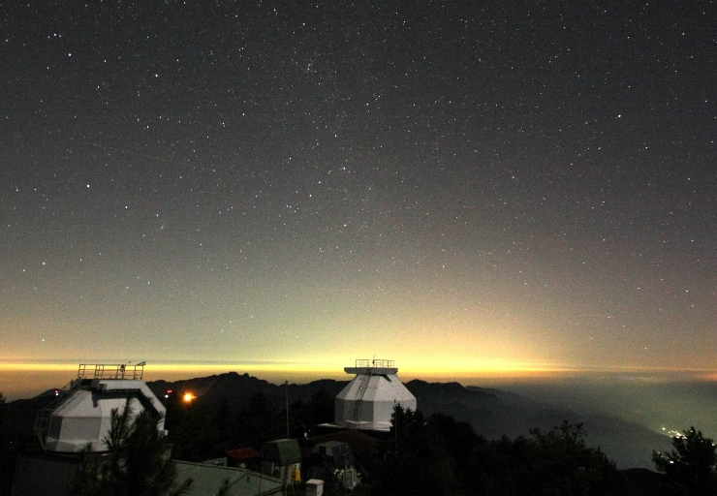
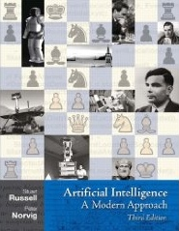
AI as Techniques?
AI Bible
Part I Artificial Intelligence Agents Part II Problem Solving A* Search, Adversarial Search, CSP Part III Knowledge and Reasoning Logic, Knowledge Representation, Inference Part IV Uncertain Knowledge and Reasoning
Prob. Reasoning, Bayes network, Prediction Part V Machine Learning
Machine Learning, Prob. Model, Deep Learning, Reinforcement Learning Part VII Communicating, Perceiving, and Acting
Natural Language Processing (NLP), Computer Vision, Robotics

Slide 8
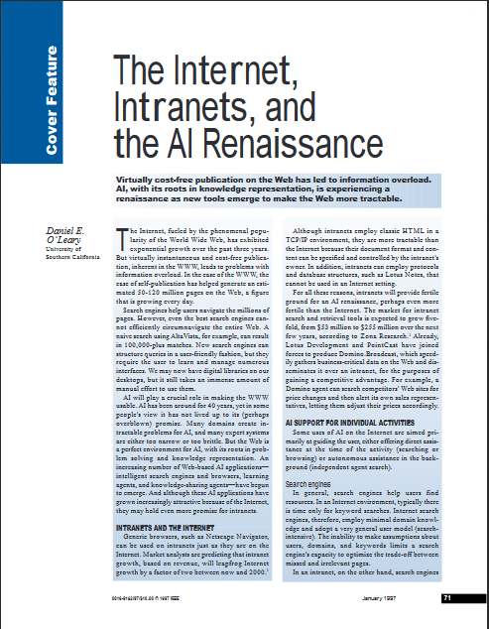
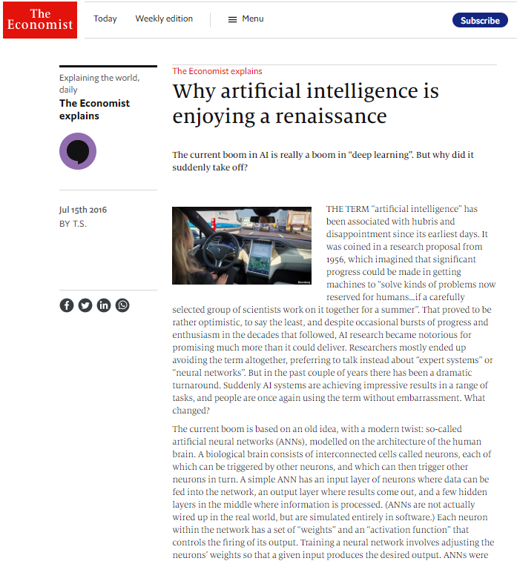
AI Renaissance
The Economist, 2017
Intelligence 1997

Slide 9
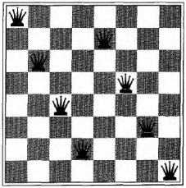
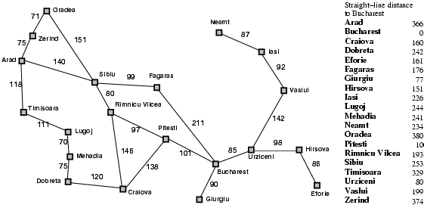

Problems
Search Algorithms
8-queens
8-puzzle
Sudoku
Shortest path
Coloring
…
Uniform Search
Depth-First Search
Breadth-First Search
A* (A-Star) Search Algorithm
Local Beam Search
Hill Climbing
Simulated annealing search

Slide 10
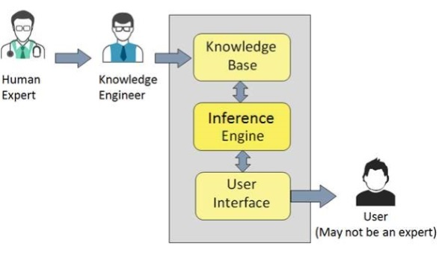
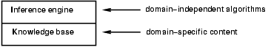
Logic Reasoning
Problem solving agents cannot infer unobserved information.
Inference
KB ├_{i} α = sentence α can be derived from KB by procedure i
Soundness: i is sound if whenever KB ├_{i} α, it is also true that KB╞ α
Completeness: i is complete if whenever KB╞ α, it is also true that KB ├_{i} α

Slide 11
Inference Rule for CNF: sound and complete!
“If A or B or C is true, but not A, then B or C must be true.”
“If A is false then B or C must be true, or if A is true
then D or E must be true, hence since A is either true or
false, B or C or D or E must be true.”
* Resolution is “refutation complete”
in that it can prove the truth of any entailed sentence by refutation.
Simplification

Slide 12
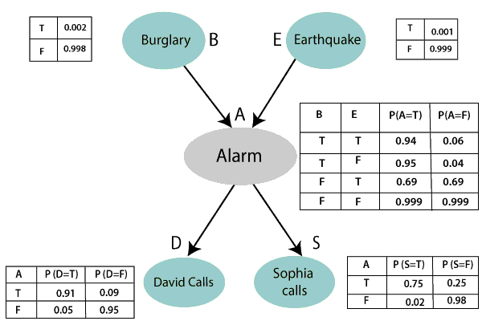
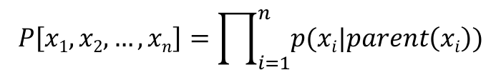
Bayesian Belief Networks
Definition:
If the network structure of the model is a directed acyclic graph, the model represents a factorization of the joint probability of all random variables.
Conditional Probability Tables
Smoothing
Inference
$$P\left[x1, x2, …, xn\right]=\prod_{i=1}^{n}{p(xi|parent\left(xi\right))}$$

Slide 13
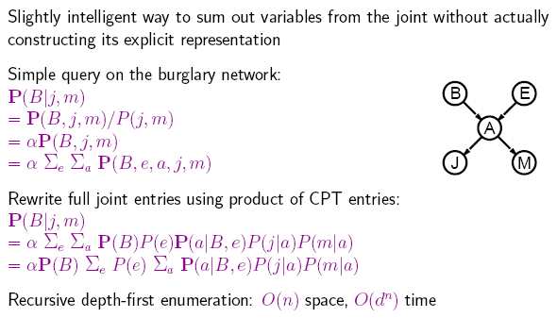
Inference by Enumeration

Slide 14
Reinforcement Learning
Reasoning Over Time
Rewards are given

Slide 15
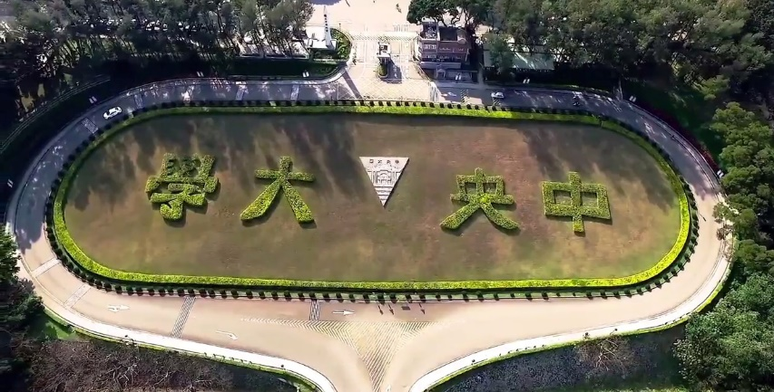
Data Mining / Big Data
Predictive (Decision Making)
Descriptive (Decision Support)
Regression
Classification
Time series analysis
Association Rules
Sequence Discovery
Clustering
Dimension Reduction
Summarization

Slide 16
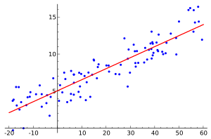
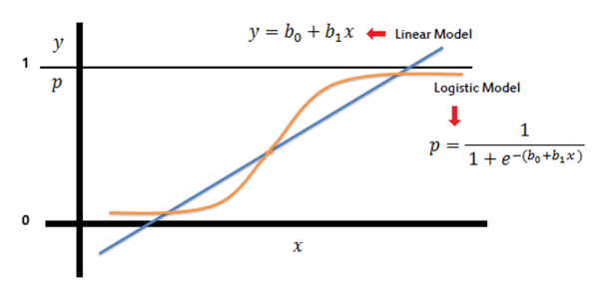
Supervised Learning
Linear Regression
Least sum of squared errors
Binary Classification
Logistic regression
Sum of squared errors (SSE)
Likelihood

Slide 17
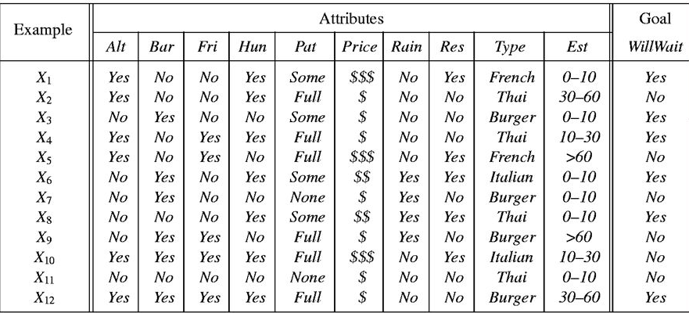
Supervised Learning: Classification
Feature Engineering
Labeled training set D: (X_{i}, Y_{i}), i=1, …, n
Each X_{i} is a vector in R^{d}

Slide 18
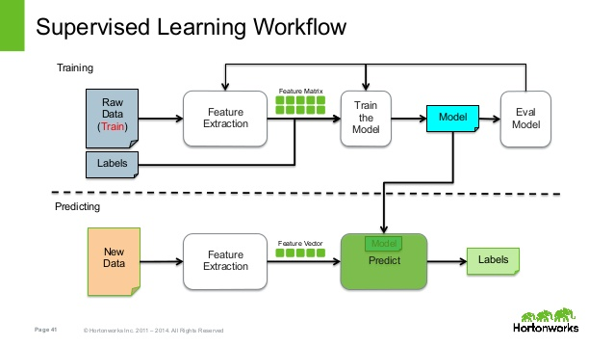
Question: How to collect a lot of labeled training examples?

Slide 19
Traditional Programming vs. “Machine” Learning
Traditional Programming
Data
Computation
Results
Program
Machine Learning Approach
Data
Computation
Program
Results

Slide 20
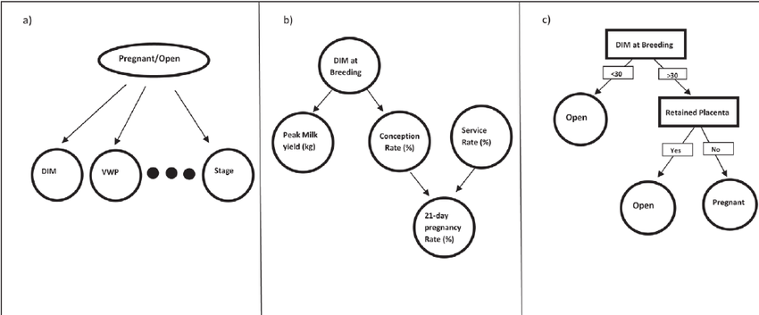

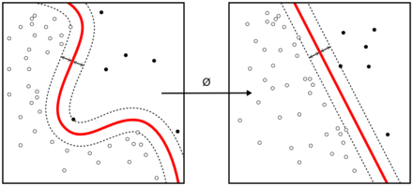
Supervised Learning Algorithms
(d)
(e)
Naïve Bayes
Decision Trees
Support Vector Machine (SVM)
Bayesian Networks
Voting/Additive (Ensemble Methods)

Slide 21
Clustering: Definition
Given a set of points, with a notion of distance between points, group the points into some number of clusters, so that
Members of a cluster are close/similar to each other
Members of different clusters are dissimilar
Usually:
Points are in a high-dimensional space
Similarity is defined using a distance measure
Euclidean (data points)
Cosine (vectors),
Jaccard (set),
Edit distance (string), …
x
xx x
x x
x x x
x
x x x
x
x x
x x x x
x x x x
x x x
x x
x x
x x x x
x x x x
x x x
x x
x x
x x x x
x x x
x
x x
x x x x
x x x
x
x
Outlier
Cluster

Slide 22
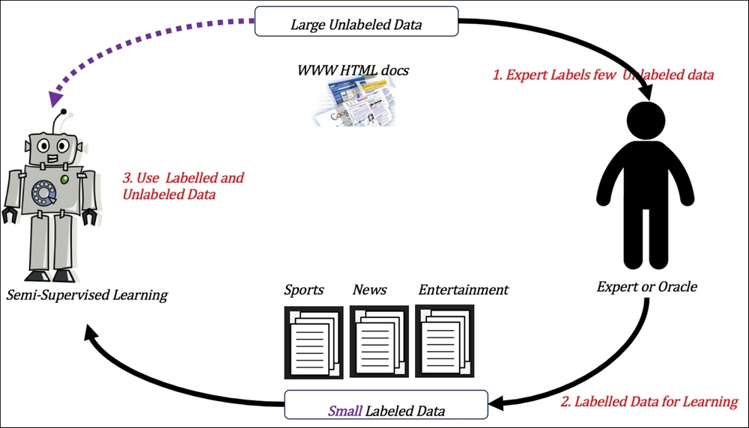
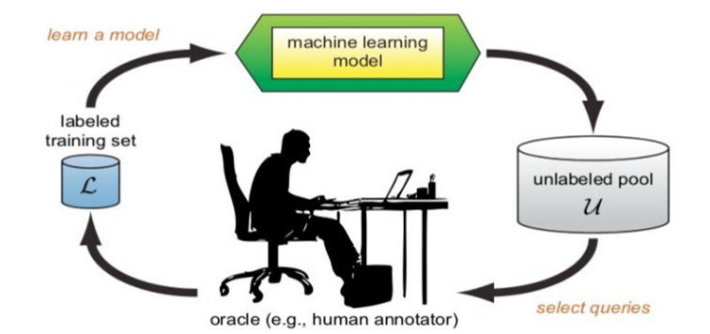
Between Supervised & Unsupervised
Semi-supervised learning
Active learning

Slide 25

linear regression 有沒有 local optimal?
ⓘ Start presenting to display the poll results on this slide.

Slide 26

請問關於監督式學習、非監督式學習以及半監督式學習，下列敘述何者正確?(複選)
ⓘ Start presenting to display the poll results on this slide.

Slide 27


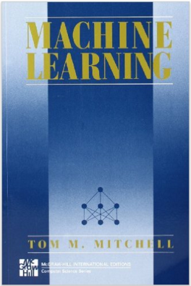
Machine Learning Books
2nd ed. (2006);
1st ed. (1997)

Slide 28
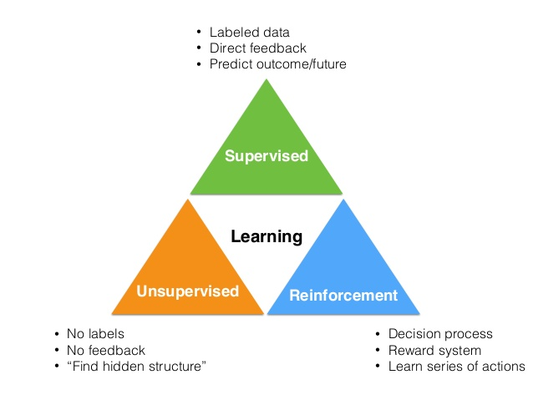
Machine Learning
Tasks
Techniques/Algorithms
Supervised Learning
Regression
Classification
Sequence Labeling
Structure Learning
Unsupervised Learning
Clustering
Anomaly detection
Representation Learning
Reinforcement Learning
Decision making over time
(Control Learning)
Decision Tree
K-Nearest Neighbor
Bayesian Networks
Neural Networks
Support Vector Machines
Genetic Algorithms
K-means, EM Algorithms
Hierarchical Agglomerative Clustering
PCA
AutoEncoder
Q-Learning
SALSA

Slide 29
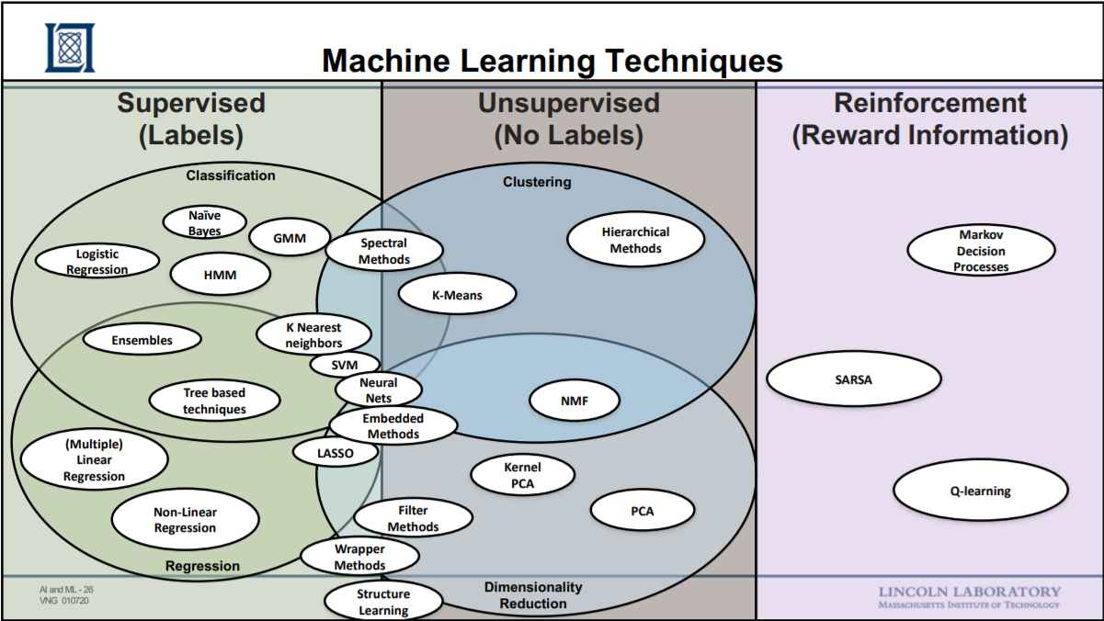
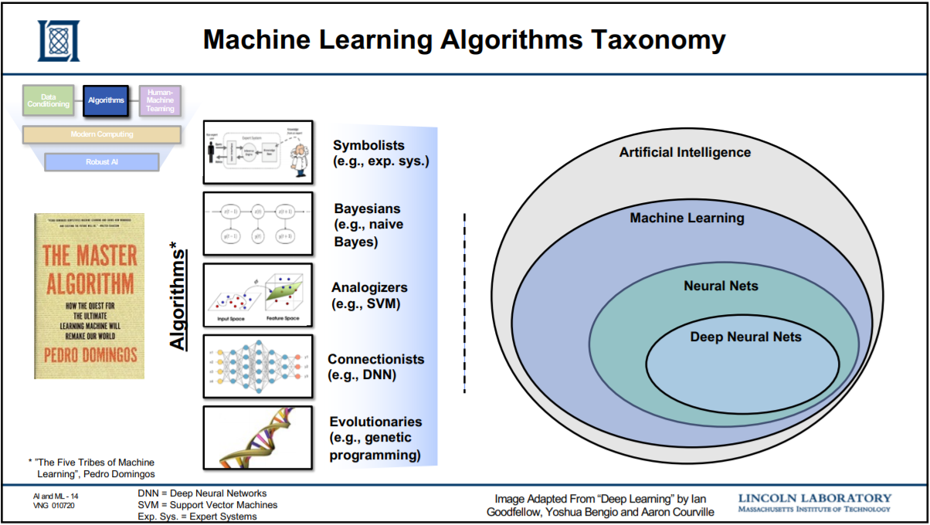

Slide 30
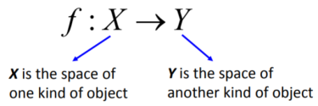
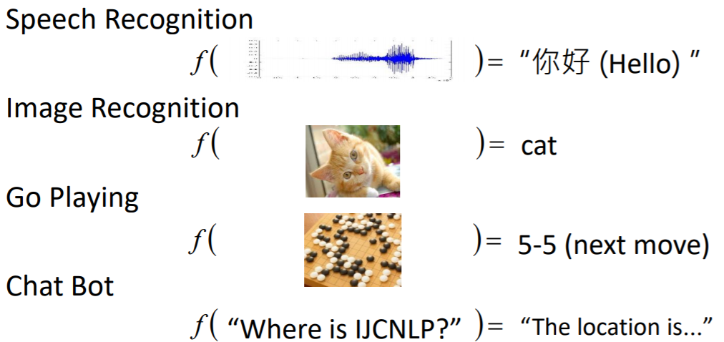
Machine Learning as Finding a Function
Function = Soft Machine

Slide 31
Traditional Programming vs. Machine Learning
Data
Computation
Results
Program

Slide 32
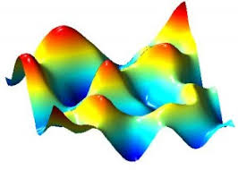
Statistical Machine Learning
Cost Function
Likelihood
Mean squared error
Optimization
Stochastic Gradient Descent
This is why CS freshmen needs to learn calculus
Learning Theory
Avoid overfitting

Slide 33
Common ML Pitfalls
Over-fitting vs. Under-fitting
Bad/noisy/missing data
Model selection
Lack of success metrics
Linear vs. Non-linear models
Ignoring outliers
Training vs. testing data
Computational complexity, curse of dimensionality

Slide 34
請選出關於監督式學習和強化式學習正確的敘述(複選)
ⓘ Start presenting to display the poll results on this slide.

Slide 35
It’s All About Optimization
What is the Solution Space?
Combinatorial
Numerical values
Objective/Cost function
Which solution has higher probability?
Which solution has the lowest cost?
Algorithm
Search/inference Algorithm
Gradient Descent Algorithm
Decision over time

Slide 36
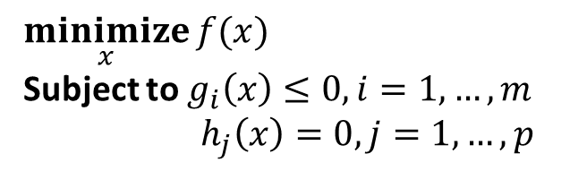
How to Find the Best Model? Optimization
$$\underset{x}{minimize}{f(x)}$$
Subject to $g_{i}\left(x\right)≤0, i=1, …, m$
$${ h}_{j}\left(x\right)=0, j=1,…, p$$
General form:
where
ƒ(x) : R^{n} → R is the objective function to be minimized over the variable x,
g_{i}(x) ≤ 0 are called inequality constraints, and
h_{i}(x) = 0 are called equality constraints.
Special cases:
Unconstrained Optimization, m=p=0
Linear constrained Optimization: g_{i}(x) and h_{i}(x) are linear
Nonlinear constrained Optimization
Quadratic Programming
x here denotes weighting variables

Slide 37
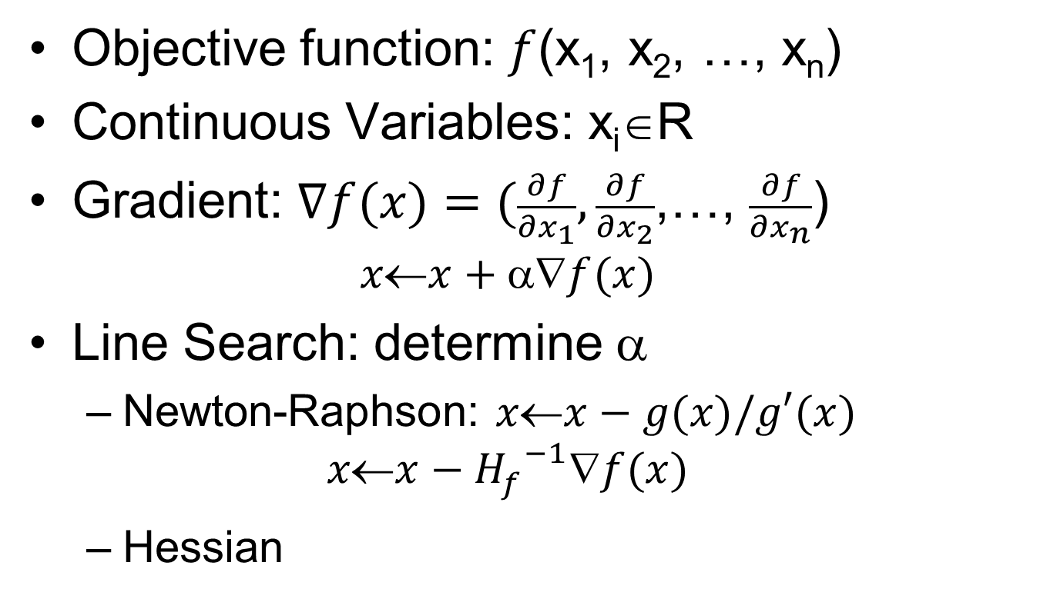
Local Search in Continuous Spaces

Slide 38
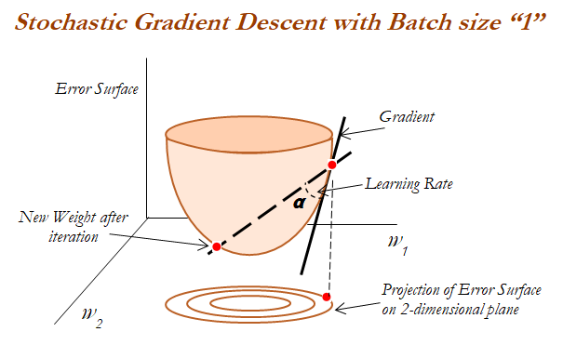
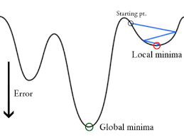
Illustration

Slide 40
請選出關於 optimization 正確敘述?
ⓘ Start presenting to display the poll results on this slide.

Slide 41
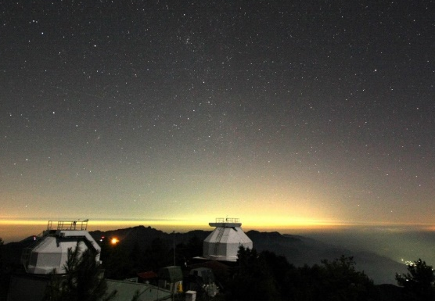

From ML to Deep Learning
Part I: Applied Math and Machine Learning Basics
2 Linear Algebra
3 Probability and Information Theory
4 Numerical Computation
5 Machine Learning Basics
Part II: Modern Practical Deep Networks
6 Deep Feedforward Networks
7 Regularization for Deep Learning
8 Optimization for Training Deep Models
9 Convolutional Networks
10 Sequence Modeling: Recurrent and Recursive Nets
11 Practical Methodology
12 Applications
Part III: Deep Learning Research
13 Linear Factor Models
14 Autoencoders
15 Representation Learning
16 Structured Probabilistic Models for Deep Learning
17 Monte Carlo Methods
18 Confronting the Partition Function
19 Approximate Inference
20 Deep Generative Models

Slide 42

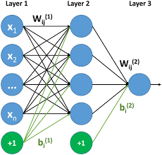
AI, ML, DL History
Engineering of making intelligent Machines and Programs
Ability to learn without being explicitly programmed
Learning based on Deep Neural Netwrork

Slide 43
Traditional machine learning vs. Deep learning

Slide 44
Artificial Neural Networks
Perceptron/Neuron
Neural networks

Slide 45
Back Propagation
https://www.superdatascience.com/blogs/artificial-neural-networks-how-do-neural-networks-learn

Slide 46
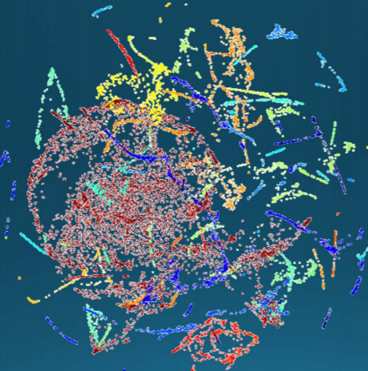
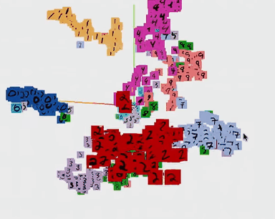
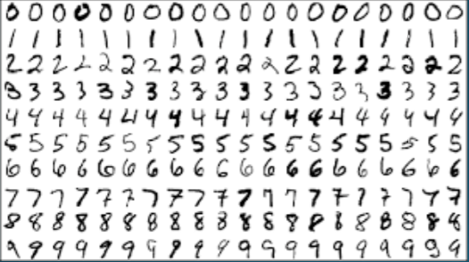
Manifold Hypothesis
Each manifold represents a different class/concept
A collection of points forming a certain kind of set, such as those of a topologically closed surface or an analog of this in three or more dimensions.
Understanding data by separating the manifolds

Slide 47
請問有關 Artificial Neural Network(ANN) 下列敘述何者為誤?
ⓘ Start presenting to display the poll results on this slide.

Slide 48
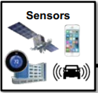

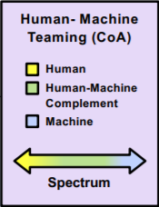

AI Canonical Architecture
Lincoln Laboratory, MIT
Knowledge Base
Supervised vs. Unsupervised
Reinforcement Learning
Data Conditioning
Algorithms
Human-Computer Teaming
Hardware Computing
Robust AI
Explainable AI
Security
Policy, Ethics, etc.

Slide 49
The Five Tribes of Machine Learning
By Pedro Domings (Washington U.)

Slide 50
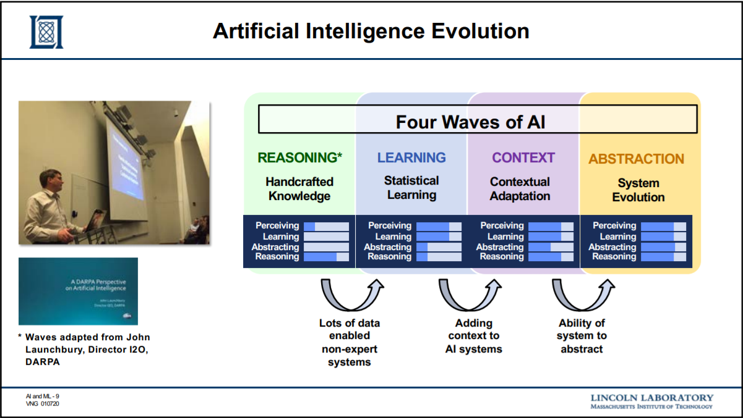
DARPA Perspective of AI
By DARPA
Three waves of AI
Hand crafted knowledge
Statistical learning
Contextual Adaptation

Slide 51
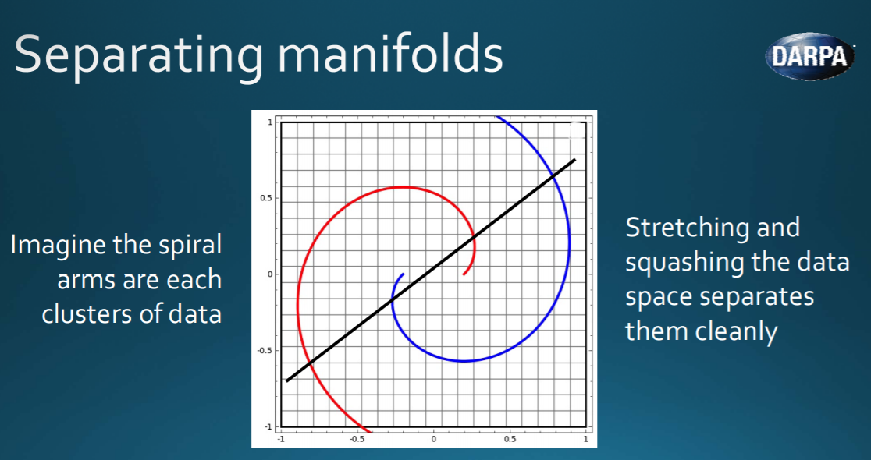
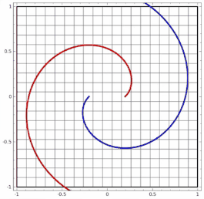
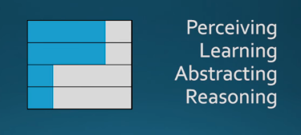
The Second wave of AI
Engineers create statistical models for specific problem domains
Train them on big data

Slide 52
Challenges of the 2nd Wave AI
Too many examples

Slide 53
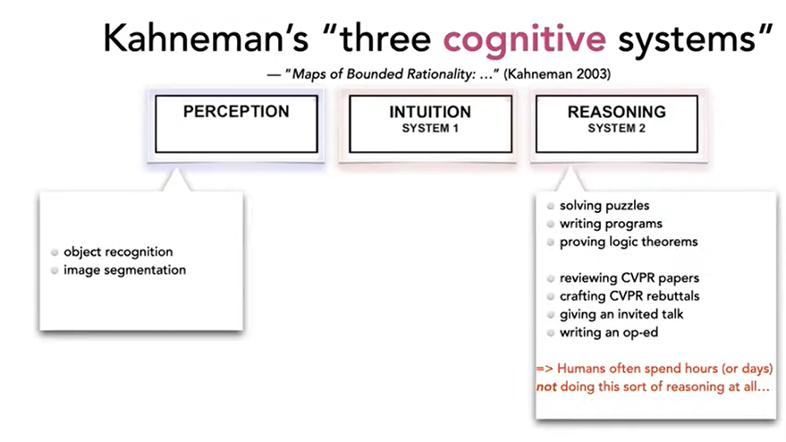


Slide 54
What do I need to learn ML?

Slide 55
What do I need to learn AI or ML?
Programming
Linear Algebra (Data matrix)
Probability/Likelihood
Calculus for Gradient Descent
Algorithm

Slide 56
What courses NCU provides?
Artificial Intelligence
Data Mining / Data Science
Machine Learning
Optimization
Bayesian Learning
Deep Learning
Natural Language Processing
Web IE & IR
Computer Vision
Image Processing
Automatic Speech Recognition

Slide 57
Course Topics
Machine Learning (Week 2-4)
Supervised Learning: Regression, Classification, Bayes networks Unsupervised Learning: clustering, dimension reduction, EM algorithm
Learning from Rewards (Probabilistic Reasoning over time ) (Week 5-7)
Hidden Markov Model, Kalman Filters
Markov Decision Process, Bandit problems, Reinforcement learning Problem Solving (Week 9 – 10) A* Search, Adversarial Search CSP, Bayesian Networks (Week 11 – 12) Constraint Satisfaction Problem, Bayesian Networks (Gibbs sampling)

Slide 58
Grading
Week | Date | Topic
1 | 2022/09/15 | Introduction to AI
2 | 2022/09/22 | Machine Learning Basics: Regression
3 | 2022/09/29 | Classification: SVM, SVR
4 | 2022/10/06 | Clustering, Dimension Reduction
5 | 2022/10/13 | HMM, MDP
6 | 2022/10/20 | Q-Learning, Policy Gradient
7 | 2022/10/27 | A3C
8 | 2022/11/03 | Search Algorithm
9 | 2022/11/10 | CSP
10 | 2022/11/17 | Game Day
11 | 2022/11/24 | Bayesian Network
12 | 2022/12/01 | Exam
13 | 2022/12/08 | Deep Learning, Kalman Filter, EM Algorithm, Gibbs Sampling (Optional)
14 | 2022/12/15
15 | 2022/12/22
16 | 2022/12/29
Assignment: 45%
Regression (Stock prediction): 15%
RL (Investment): 15%
CSP or Knowledge Entailment: 15%
Term Project (Team work): 30%
Presentation (Idea + Survey)
Report (Method + Experiment)
Exam: 25%

Slide 59
Course Schedule
Week | Date | Topic | Remarks
1 | 2022/09/15 | Introduction to AI | IR Cup Introduction
2 | 2022/09/22 | Machine Learning Basics: Regression | Assignment 1 out
3 | 2022/09/29 | Classification: SVM, SVR | Team up
4 | 2022/10/06 | Clustering, Dimension Reduction | Assignment 1 Due: Stock price prediction
5 | 2022/10/13 | HMM, MDP | Assignment 2 out
6 | 2022/10/20 | Q-Learning, Policy Gradient | Project proposal scheduling
7 | 2022/10/27 | A3C | Assignment 2 Due: Stock Investment
8 | 2022/11/03 | Search Algorithm | Assignment 3 out
9 | 2022/11/10 | CSP or Knowledge Representation
10 | 2022/11/17 | Game Day | Assignment 3 Due: CSP or Search Algorithm
11 | 2022/11/24 | Bayesian Network | Progress/Final report scheduling
12 | 2022/12/01 | Exam
13 | 2022/12/08 | Deep Learning, Kalman Filter, EM Algorithm, Gibbs Sampling (Optional)
14 | 2022/12/15
15 | 2022/12/22
16 | 2022/12/29

Slide 60
Term Project
Goal: choose any task you care about and apply techniques from class
Work in groups of up to 4;
Find a group early (your responsibility), grading agnostic to group size!
Milestones: proposal, progress report, poster, final report
Task is completely open, but must follow well-defined steps: task definition, implement baselines/oracles, evaluate on dataset, literature review, error analysis (read website)

Slide 61
Policies
Gradescope: submit all assignments there
Late days: 7 total late days, max two per assignment (not for final project report, poster)
Ask questions on eeclass, do not email us directly
EEclass: extra credit for students who help answer questions

Slide 62
Questions & Answers

Slide 63

Audience Q&A Session
ⓘ Start presenting to display the audience questions on this slide.

